Slide 1
Marble Mania
By James McKelvey, Brian Ng, Michael Zhou, Brandon Qian, and Victor Li

Slide 2
Background

Slide 3

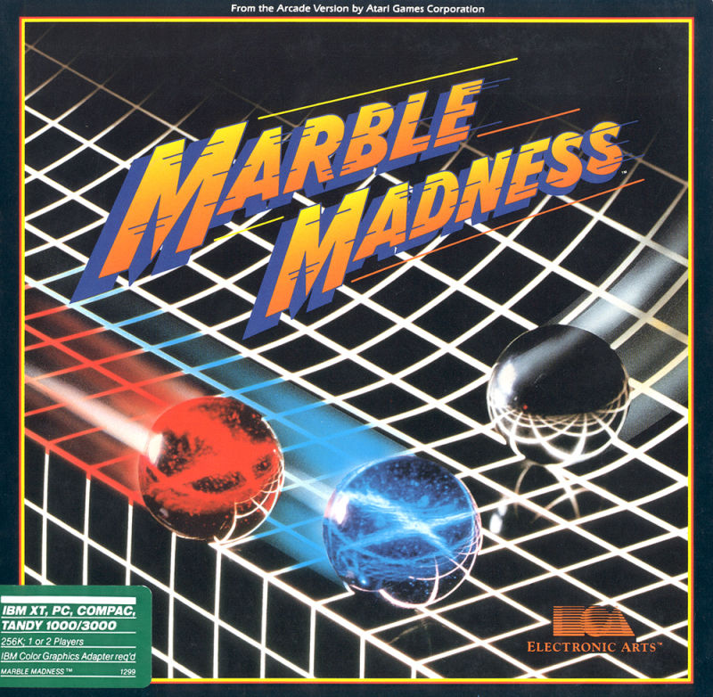
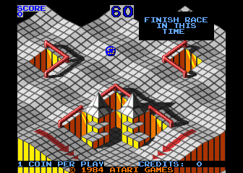
Origin
Notes:
An arcade video game that came out in 1984, Marble Madness was widely successful for its visual design, stereo soundtrack, and different levels of difficulty. Mark Cerny, the developer of Marble Madness, got the inspiration for the game from racing games, artwork, and miniature golf. It was one of the highest-earning games in the arcade and around 4,000 cabinets were sold.

Slide 4

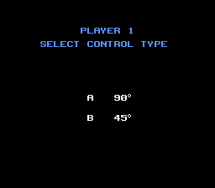
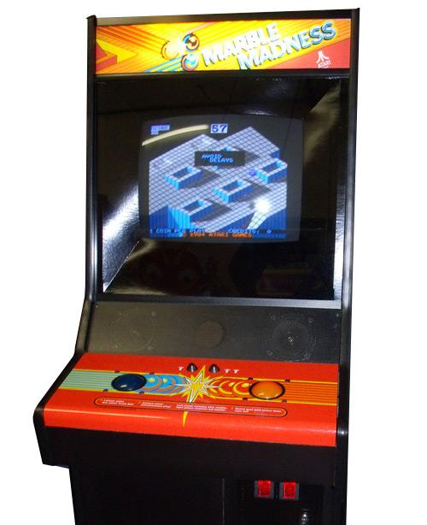
Mechanics
Notes:
​​Marble Madness is an isometric platform game in which the player manipulates an onscreen marble from a third-person perspective. In the arcade version, a player controls the marble's movements with a trackball; most home versions use game controllers with directional pads. The player's goal is to complete six maze-like isometric race courses before a set amount of time expires.

Slide 5
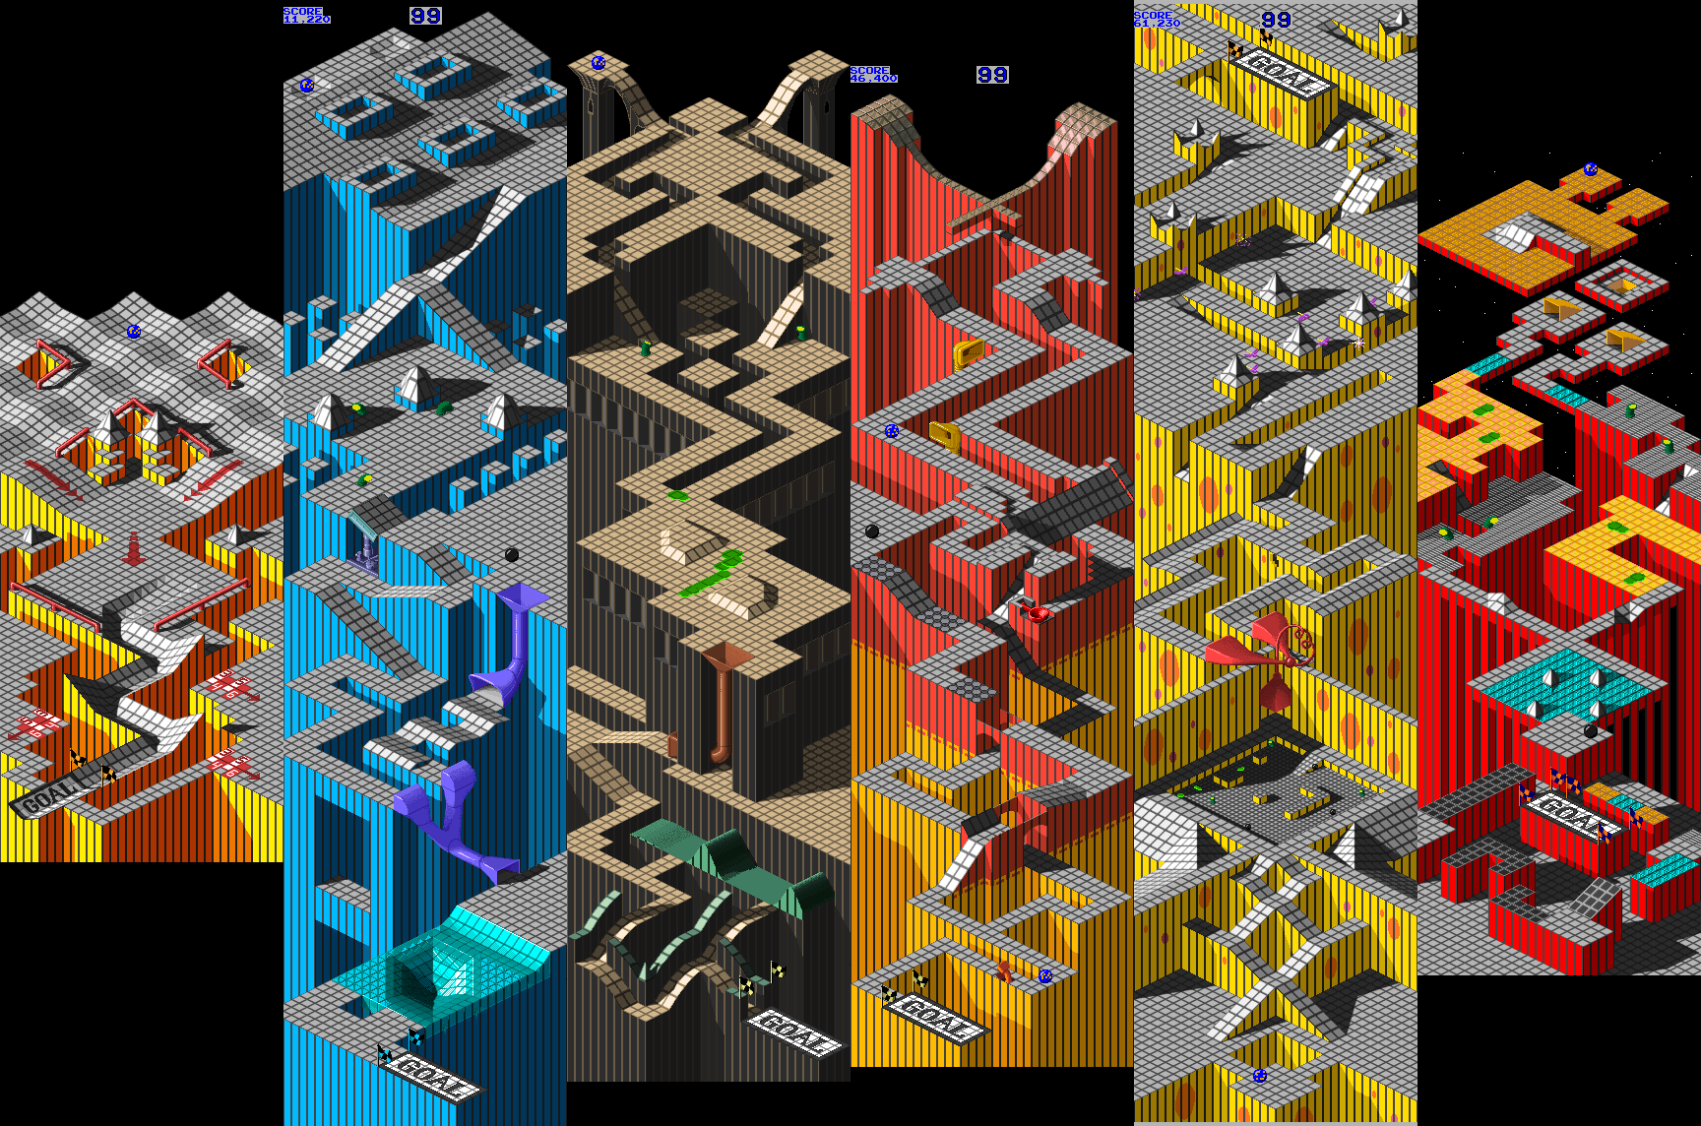
Color Palette
Notes:
The color palette of the original Marble Madness is very diverse, with touches of blue, brown, red, and yellow throughout different levels. The floor of the levels are gray scaled to limit distractions while the players proceed through different levels.

Slide 6
The Basics

Slide 7
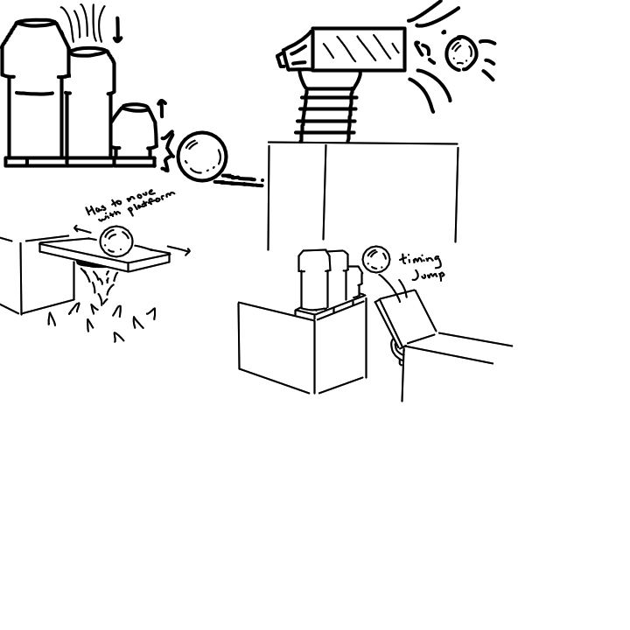
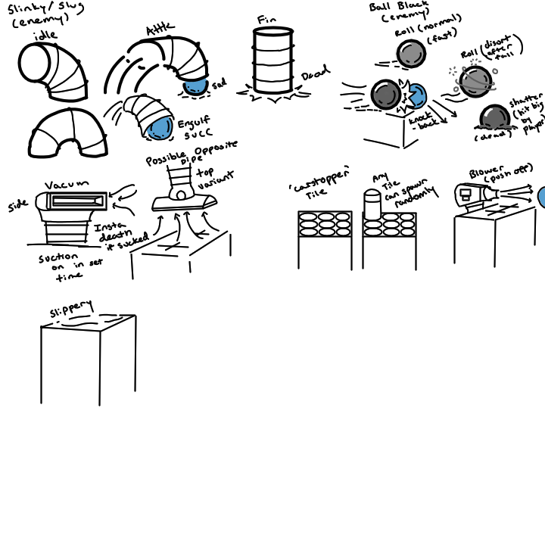
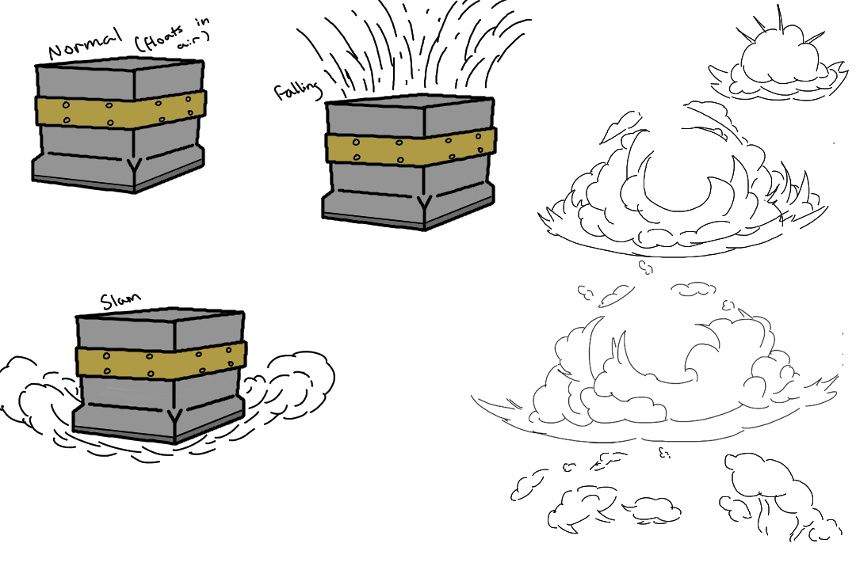
Concept Art

Slide 8
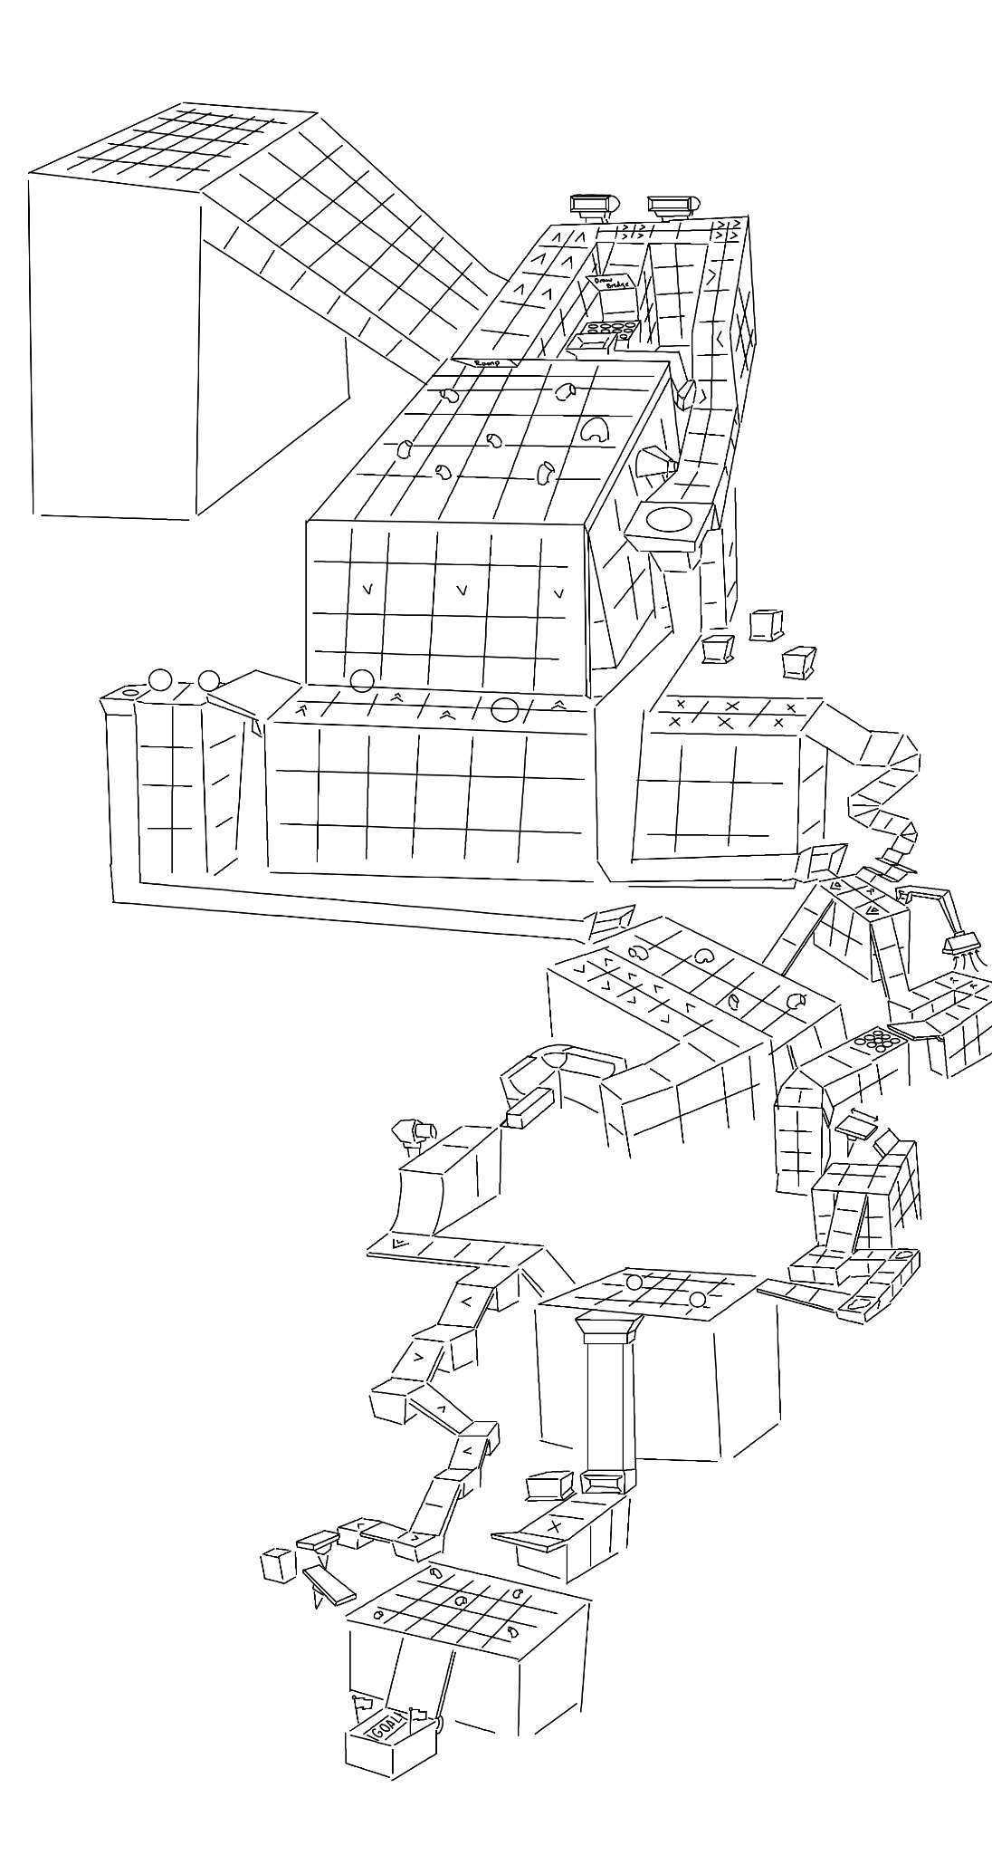



Finalizing 2D Art

Slide 9
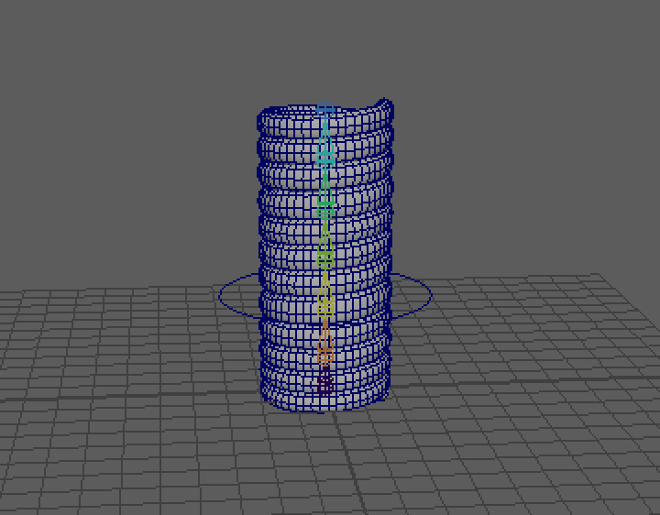
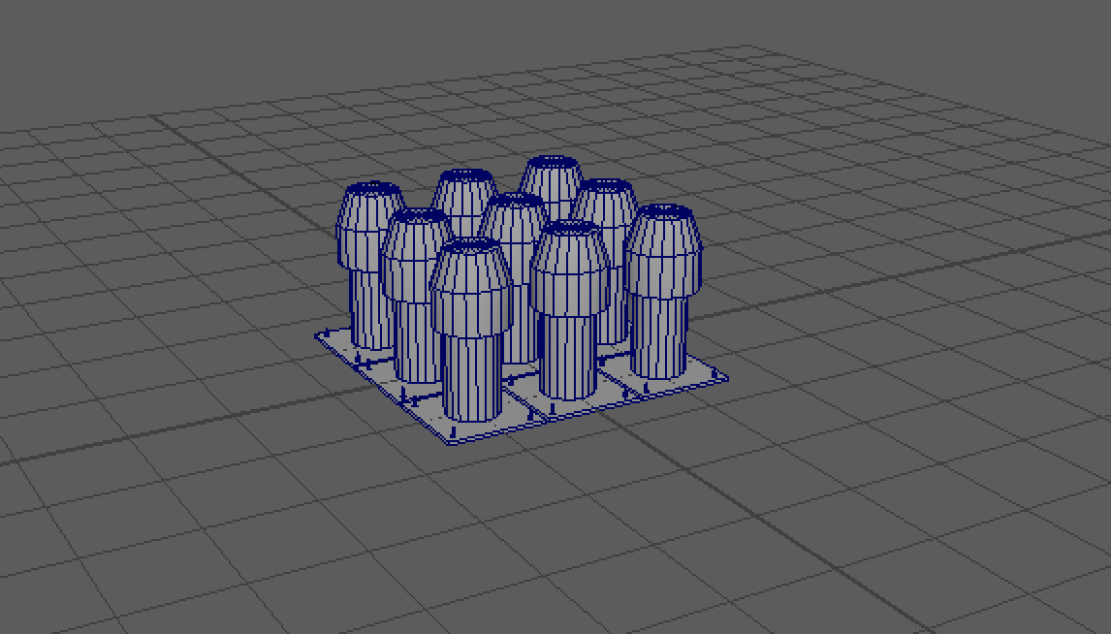
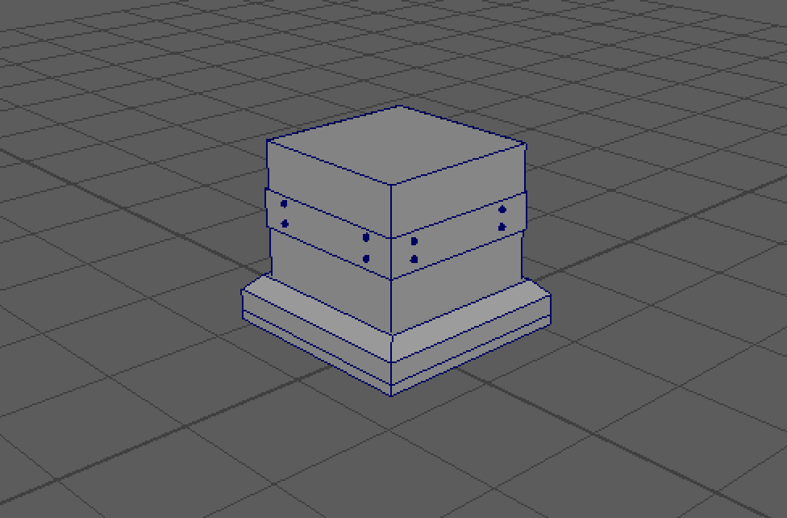
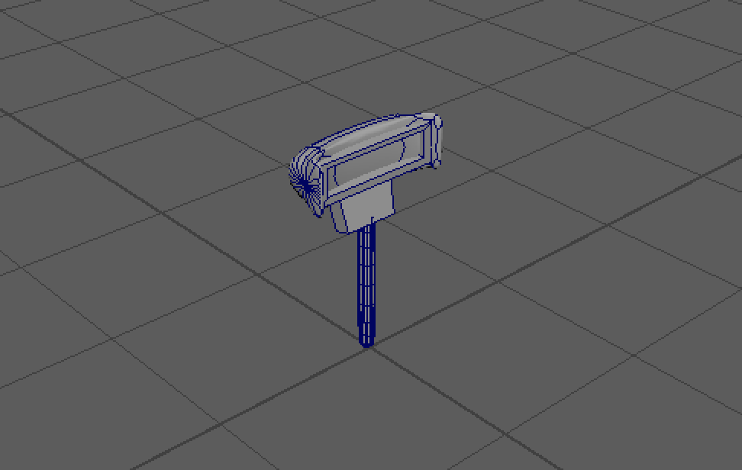
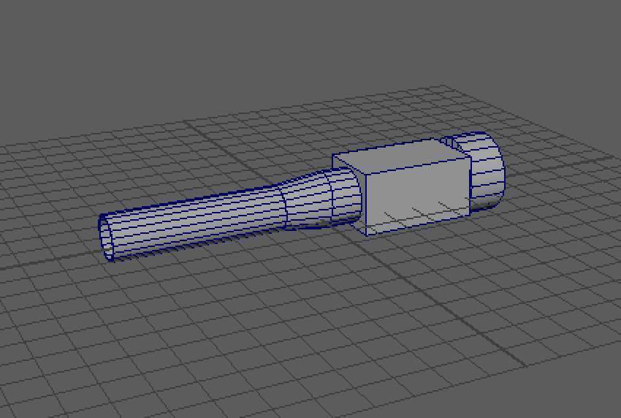
3D Modeling

Slide 10

3D Animations

Slide 11
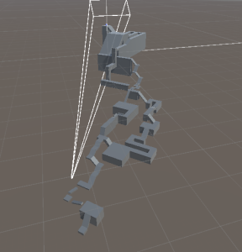
Greyboxing

Slide 12
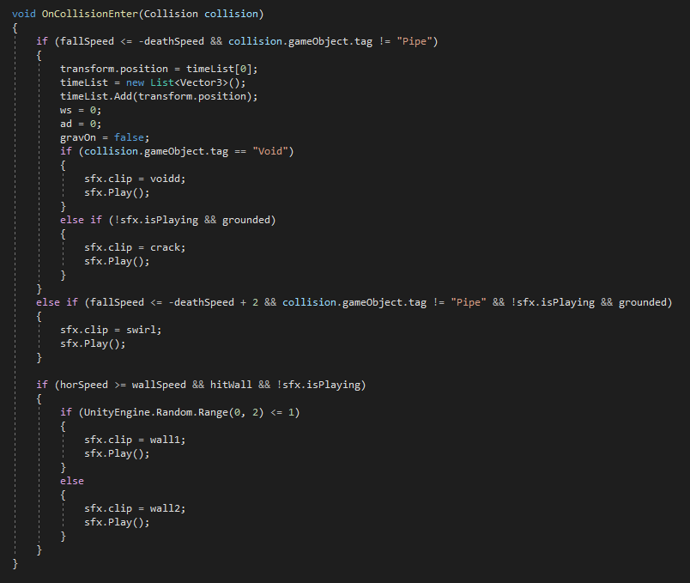
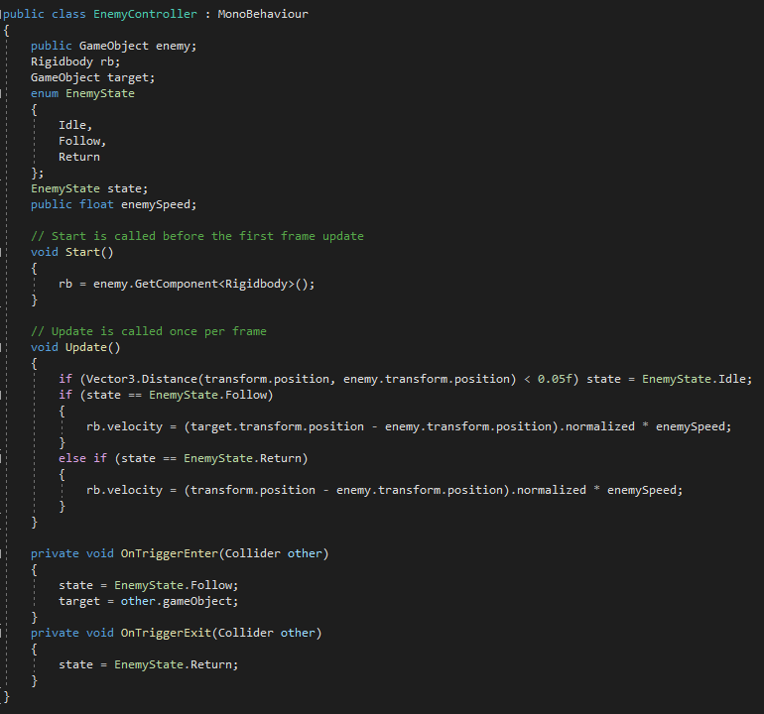
Coding

Slide 13

Music
Full Background Music
Opening Menu Music
Victory Theme Music

Slide 14
SFX
StartUp
Crusher
Void Fall
Cut Blower
Cut Swirling

Slide 15
Putting it all together...

Slide 17
Citations
https://arcadingonline.com/what-is-marble-madness-a-brief-history-how-to-play-it-and-more-2/
https://kotaku.com/unraveling-marble-madness-through-speedrunning-1797579905
https://www.mobygames.com/game/marble-madness
https://gamesdb.launchbox-app.com/games/images/83474
https://www.clipartmax.com/middle/m2i8N4Z5d3G6m2H7_blue-marble-blue-marbles-clipart/
https://en.wikipedia.org/wiki/Marble_Madness#Gameplay
https://protipoftheday.com/node/297.html
https://www.vintagearcade.net/shop/arcade-games/marble-madness-arcade-game/
https://romhustler.org/rom/mame/marble-madness-set-1
https://conceptboard.com/blog/brainstorming-techniques-templates/

Slide 18
Thank you for watching!

